Slide 1


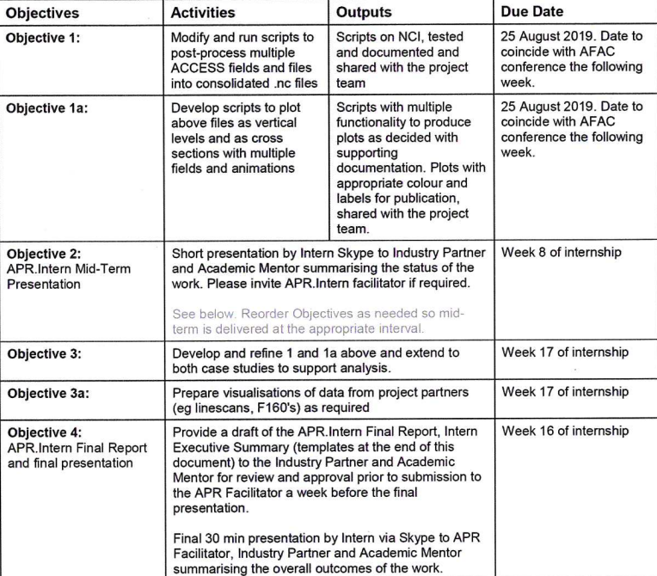

Final Presentation
Project outline (reminder)
APR Internship August '19 – March '20
Presentation ready visualisations
NCI data management
Analysis of model output
Project outputs (so far)
Objectives 1-4
Several plots presented by Mika
Poster at ACCOMC
Oral presentation for RFS clients
Other stuff
Pyrocumulonimbus (PCB) analysis
Validation of potential PCB prediction code
Framework for model output visualisations
Measurement comparisons where available
2.6 conferences, many seminars
Trajectory modelling preliminary work
Notes:
1

Slide 2
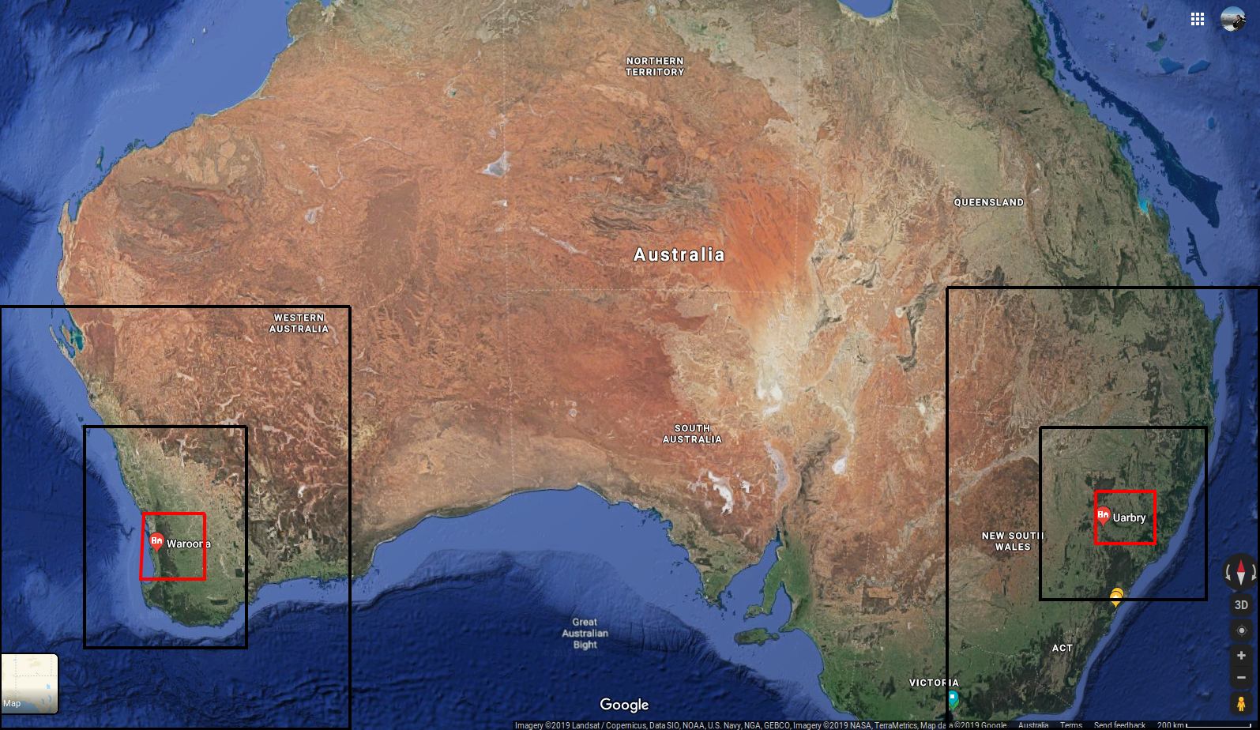
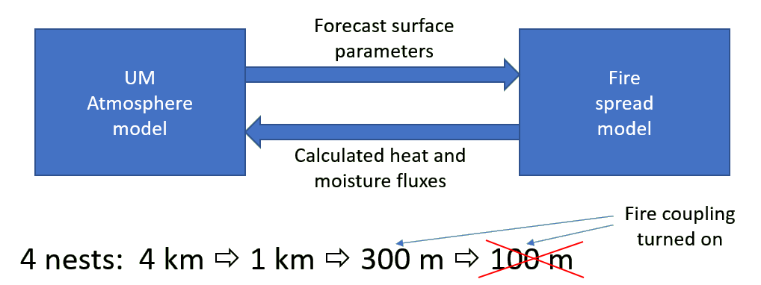
ACCESS-Fire modelling
Several model runs available currently
Three of the Waroona fire, one of the Sir Ivan fire
Fire intensity and spread based on prescribed fuel loads and modelled meteorology
Modelled meteorology affected by heat flux from the fire
Model CAN reproduce PyroCB (fire driven storm creation)
Process is sensitive to modelled boundary layer stability
Realistic fire spread is also achievable
Notes:
2
2

Slide 3
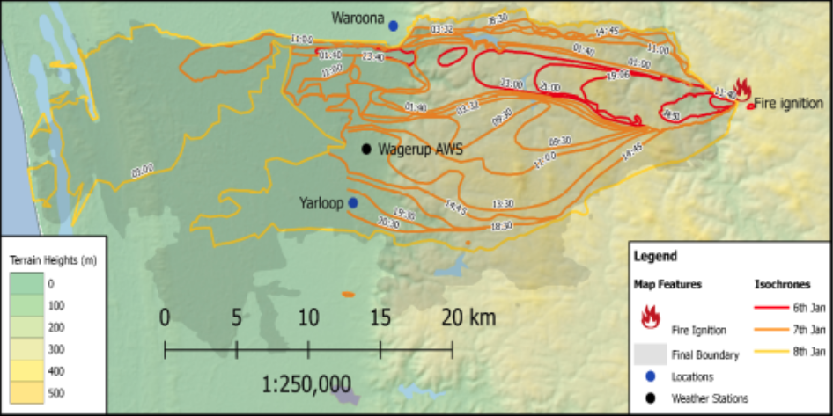
Rate of spread
On day 1
escarpment reached, due to spotting (likely) driven by PyroCB
quick westward run at the base of the scarp in the late evening
What do we see in the model?
Notes:
3
3

Slide 4
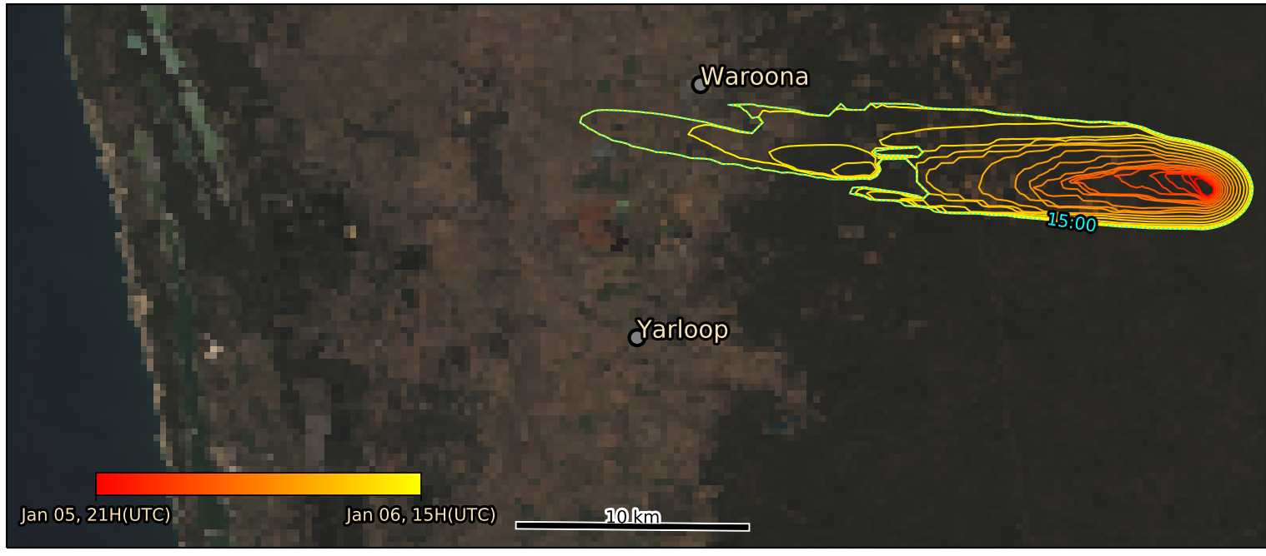
Rate of spread
15 hours of burning (Jan 6: 0900-2300)
Spotting is prescribed (not built into fire model)
Shape is relatively well represented
Fire spread affects and is sensitive to surface winds, which require careful tuning
Too much instability causes runaway fire dynamics (spread is too fast)
Too much resistance to instability can dampen physical effects (e.g., PyroCB)
Notes:
4
4

Slide 5
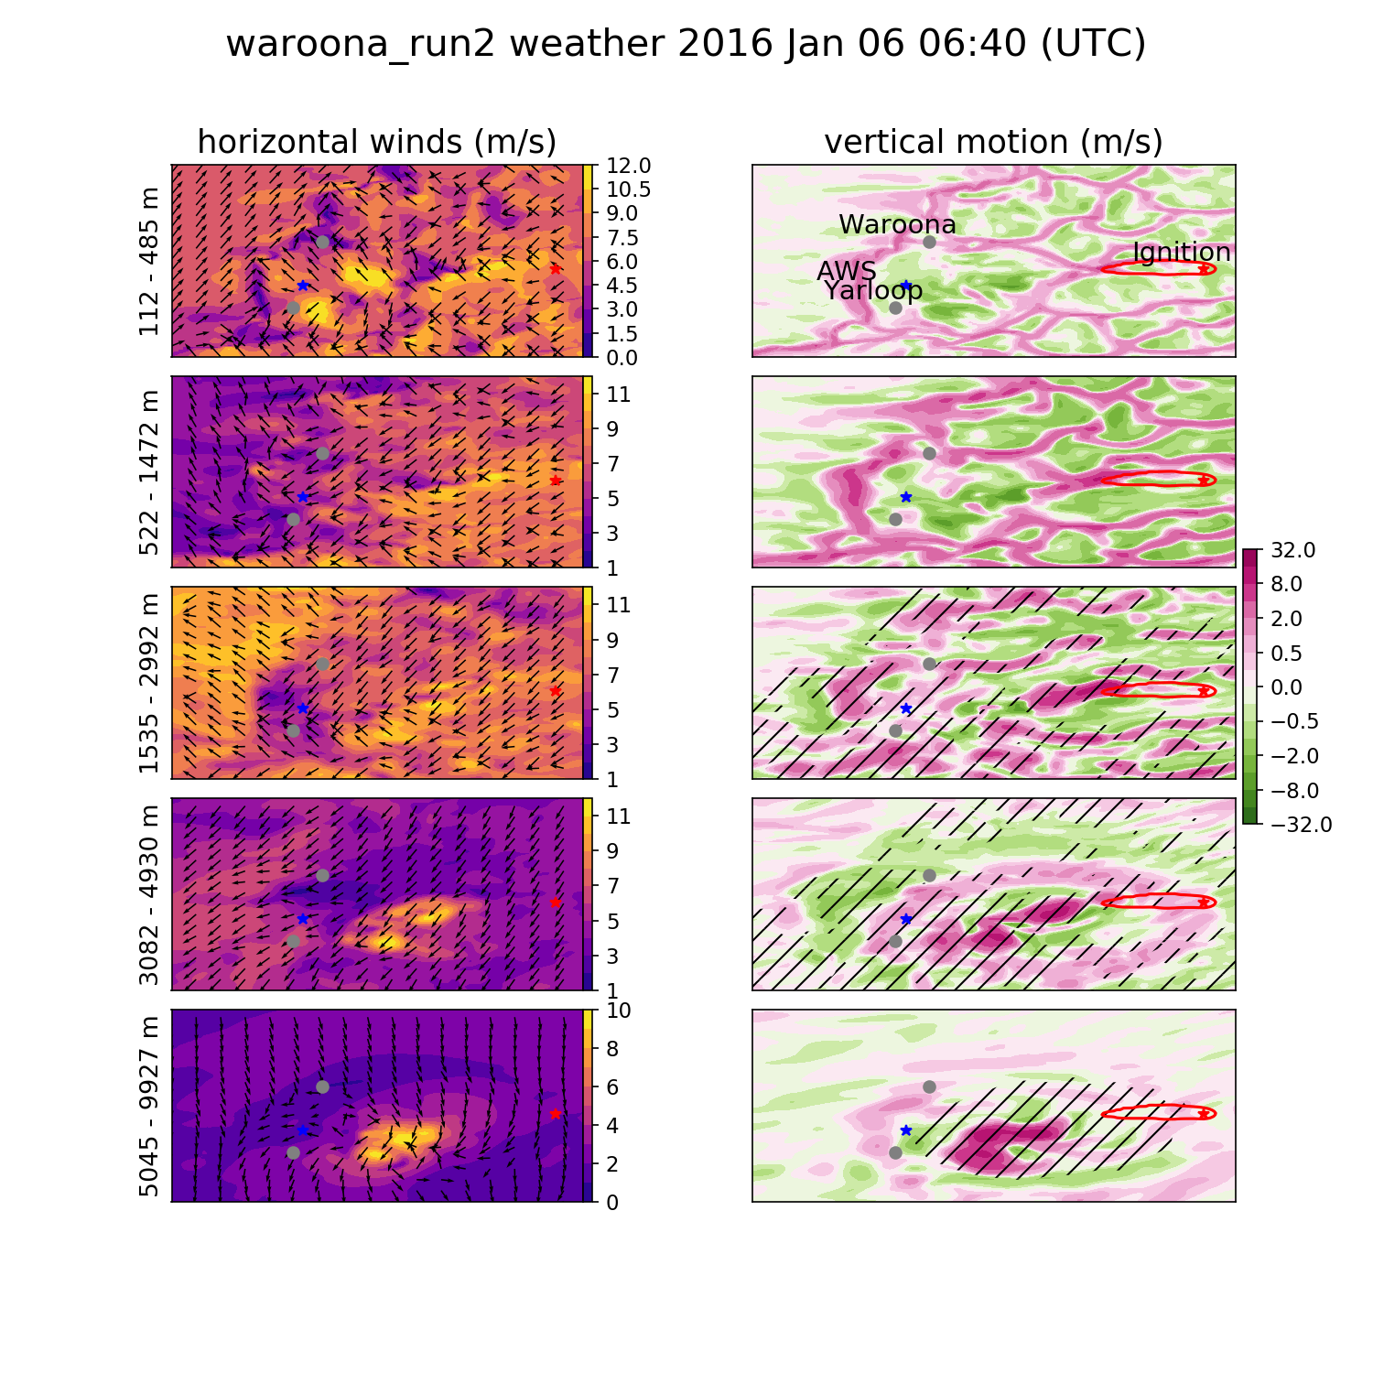
Weather summary
Notes:
5
5

Slide 6
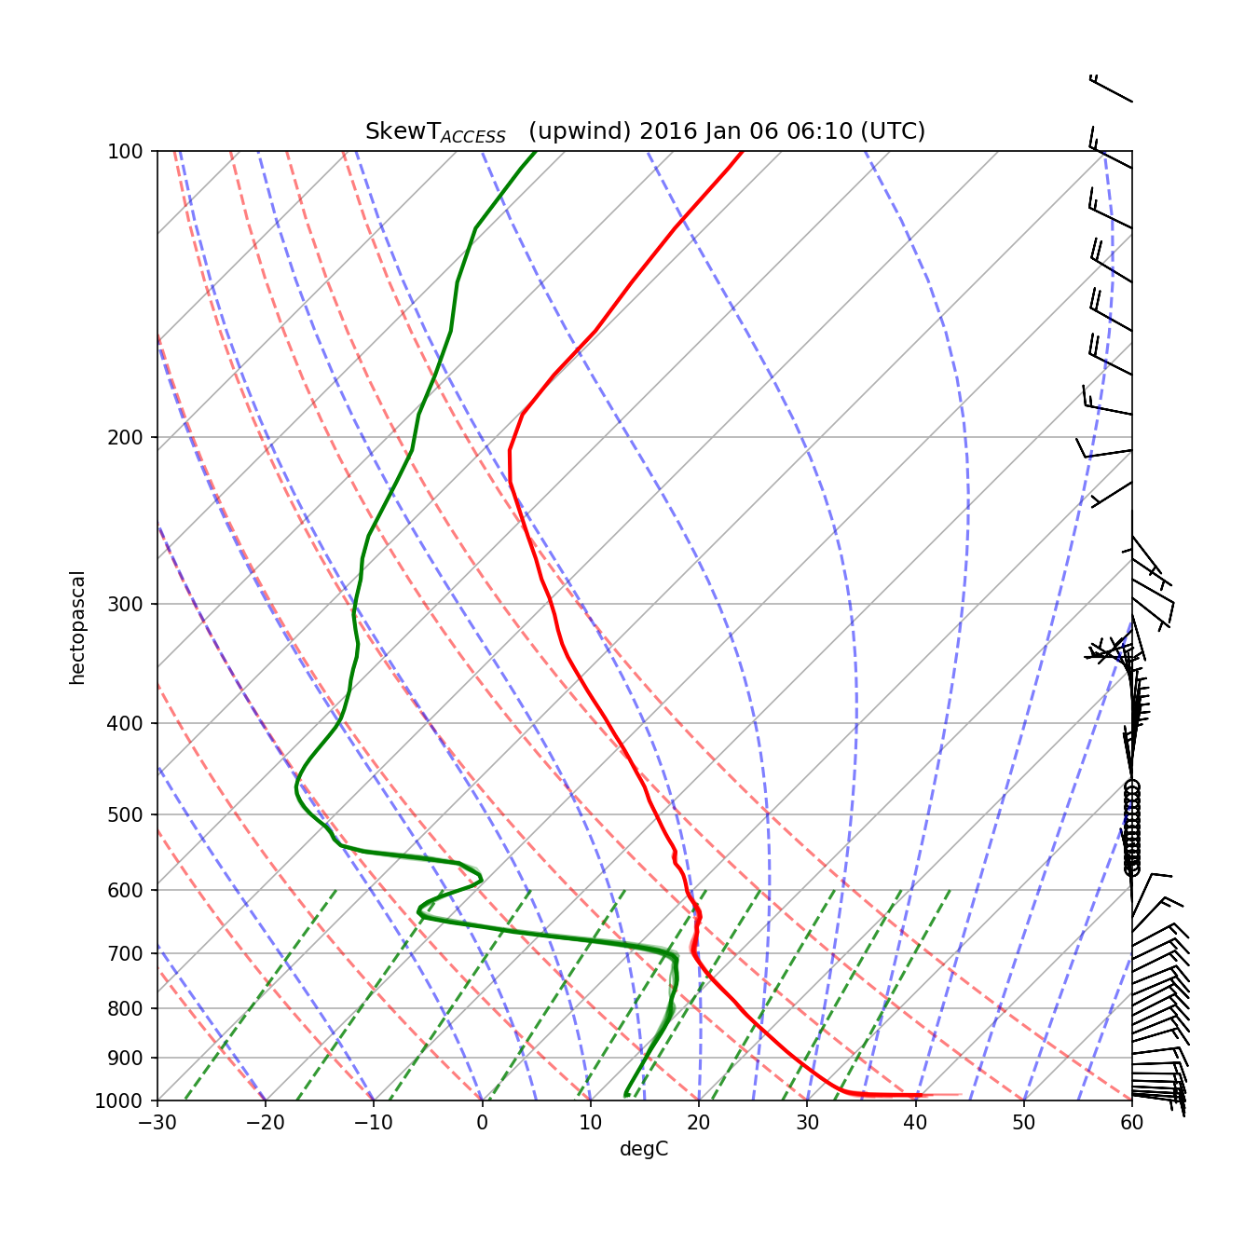
Skew T log P
PFT = C (Z_{fc})² U b_{fc}
PFT: PCB Fire power Threshold
C : constant
Z_{fc} : free convection altitude
U : wind speed
b_{fc} : Plume escape threshold
Notes:
6
6

Slide 7
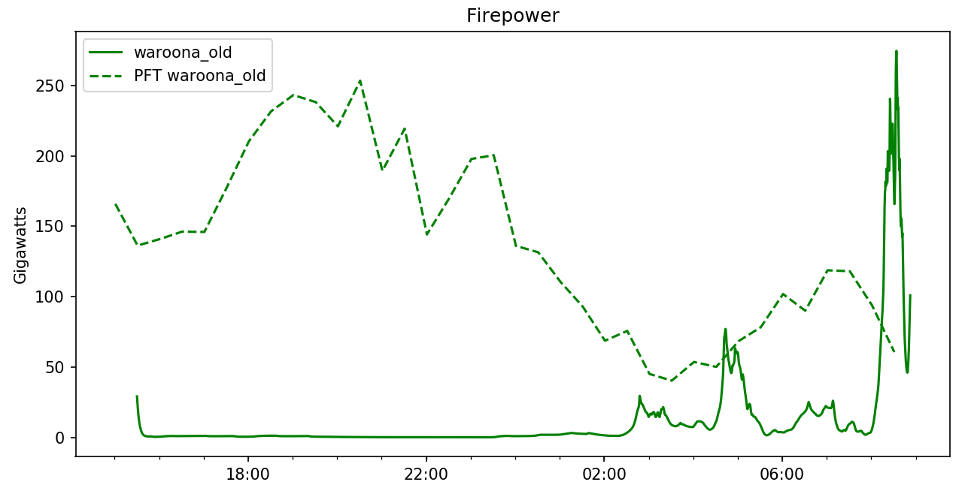
Firepower vs PFT
Original run (lower BL stability) overshoots PFT threshold at 12:30 and 1630 LT
Notes:
7
7

Slide 8
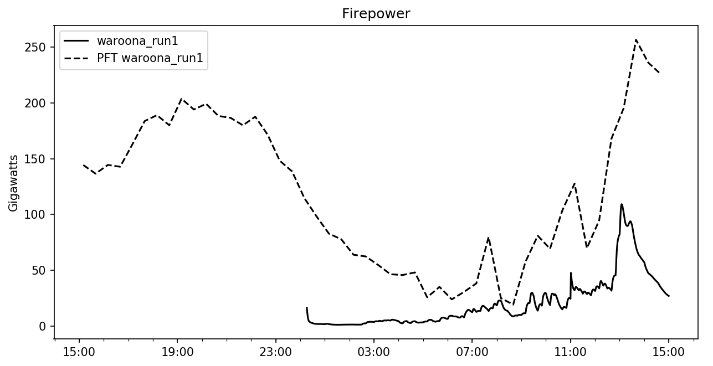
Firepower vs PFT
Newer run (higher BL stability) does not overshoot PFT
PyroCB can be seen in the original run from about 1200
Notes:
8
8

Slide 9
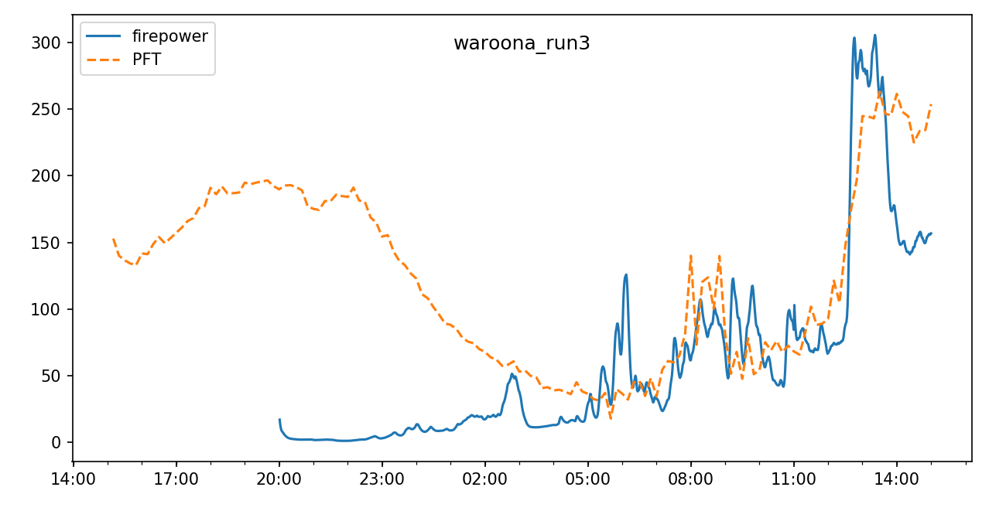
Firepower vs PFT
Latest run (higher BL stability, fewer limitations on fire spread)
PyroCB again could be expected from overshoots
Notes:
9
9

Slide 10
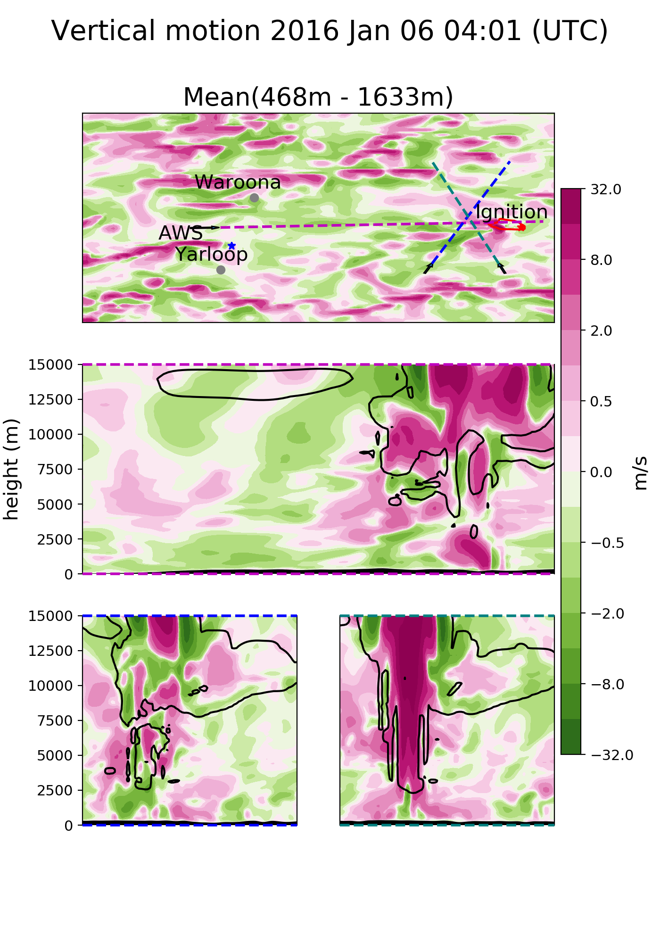
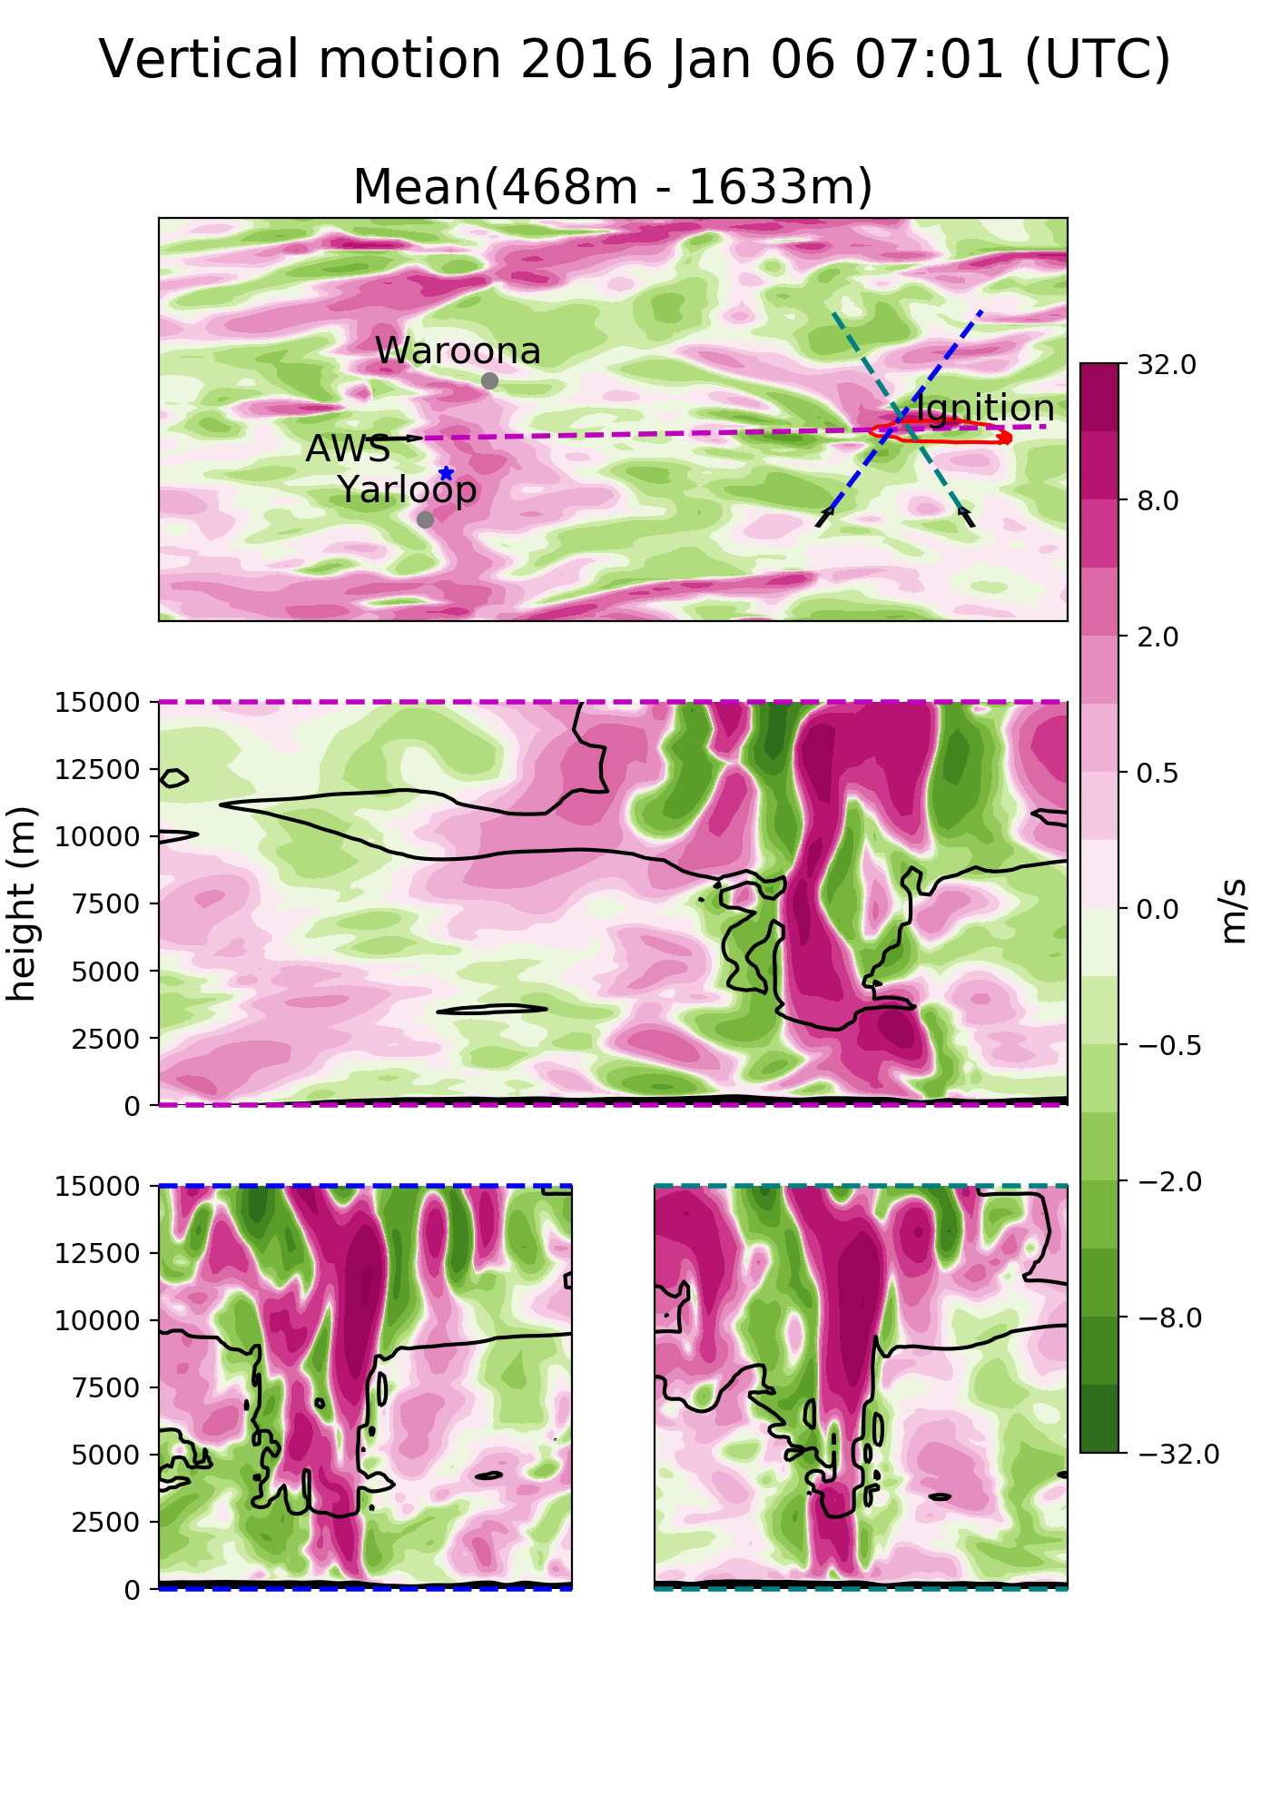
PyroCB
Strong vertical updraft throughout the troposphere over the fire front
Cloud formation and downdrafts can be seen nearby
Notes:
10
10

Slide 11
PyroCB
Strong Updraft
Strong downdrafts
Strong vertical updraft throughout the troposphere over the fire front
Cloud formation and downdrafts can be seen nearby
Notes:
11
11

Slide 12
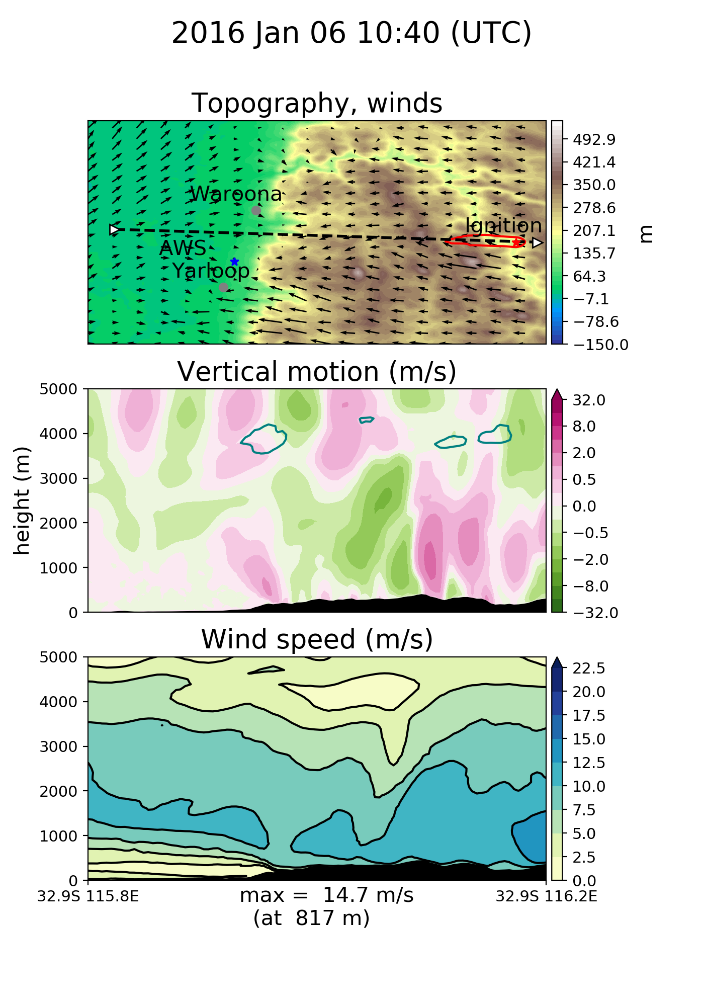
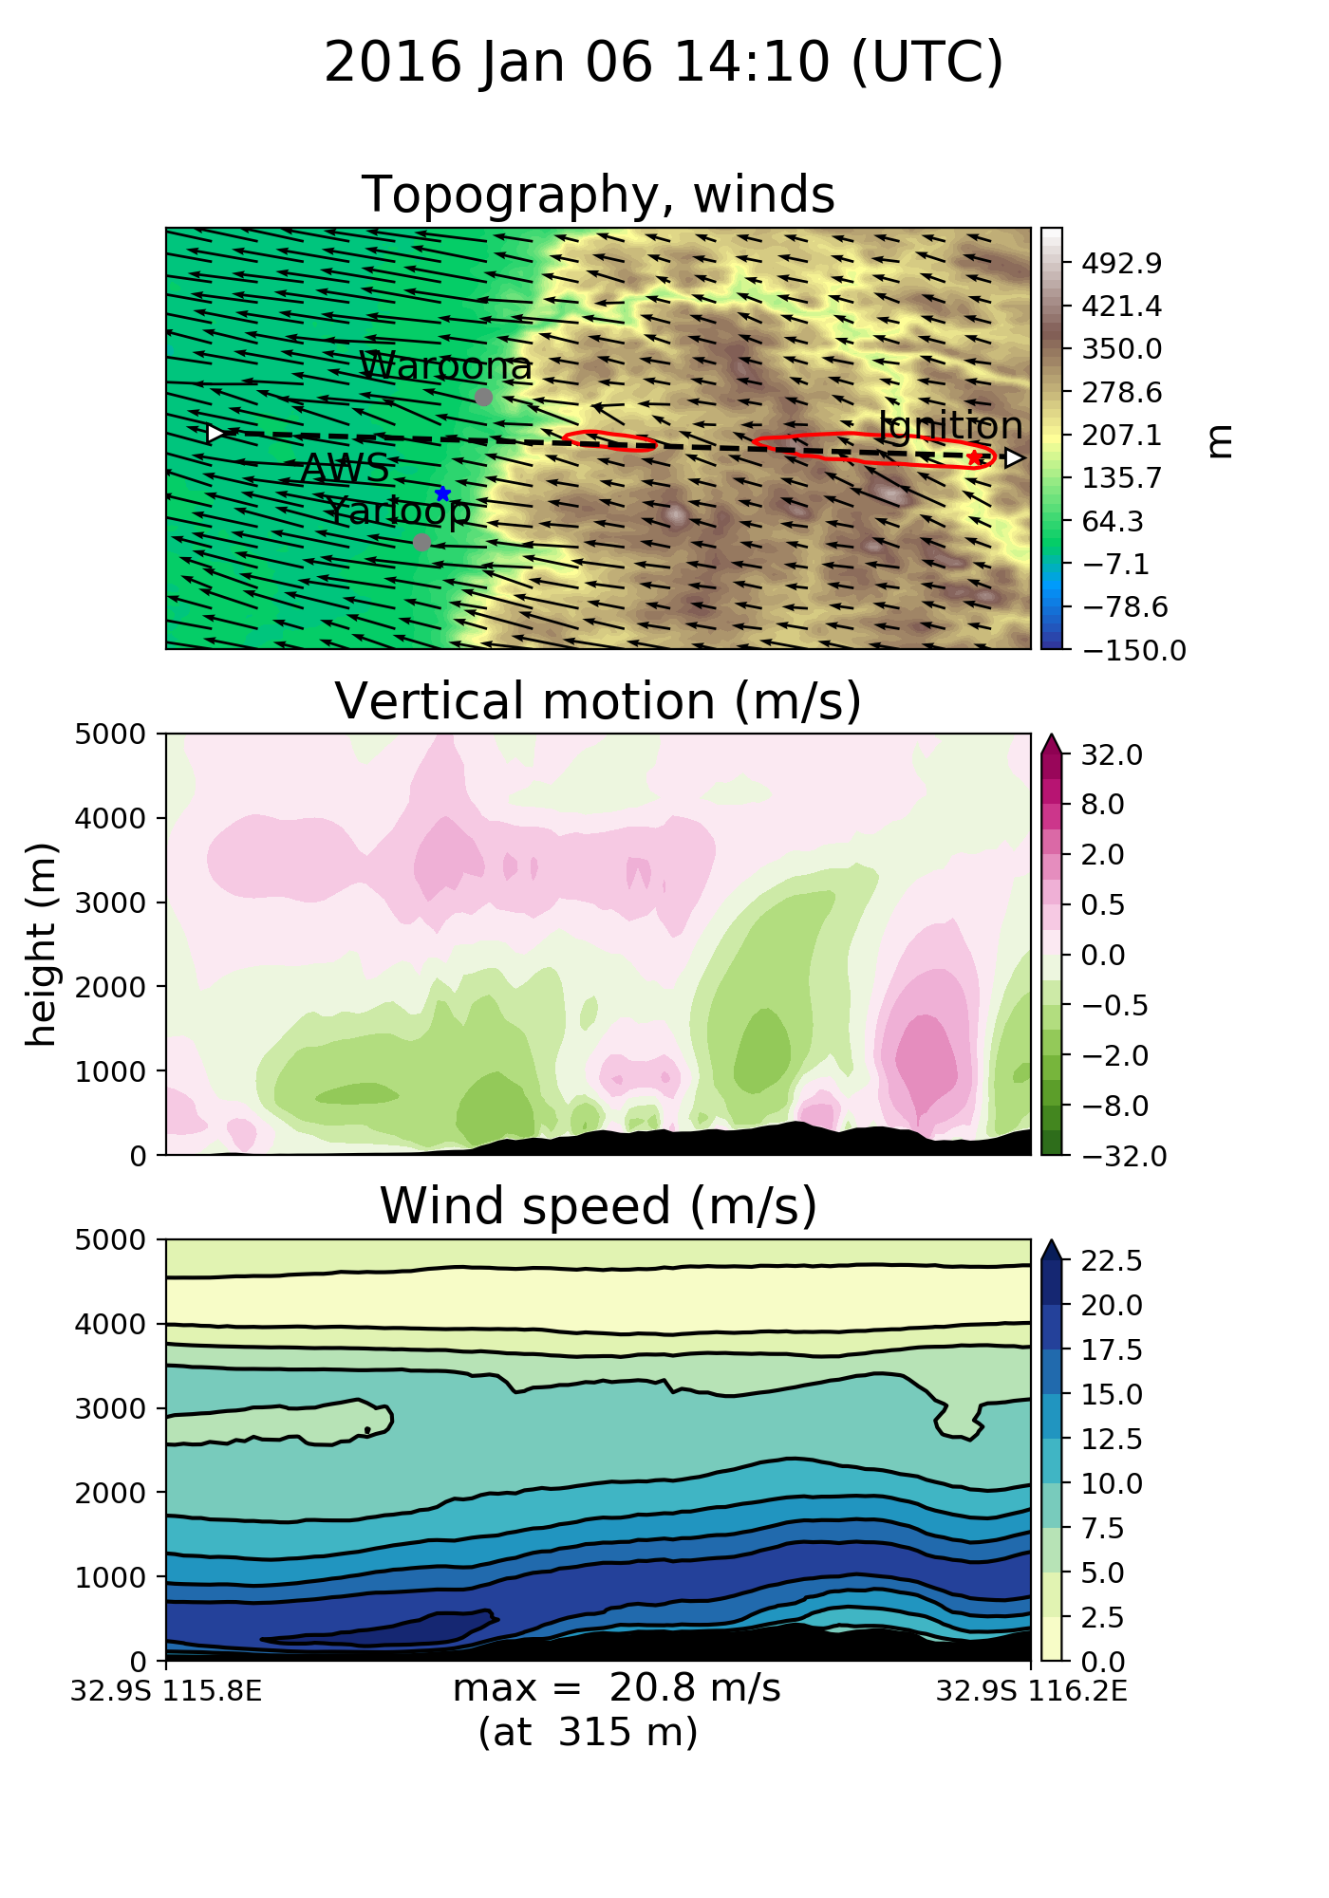
Emberstorms?
Vertical wind speeds are affected by the fire
High horizontal wind speeds seen at base of scarp
Notes:
12
12

Slide 13
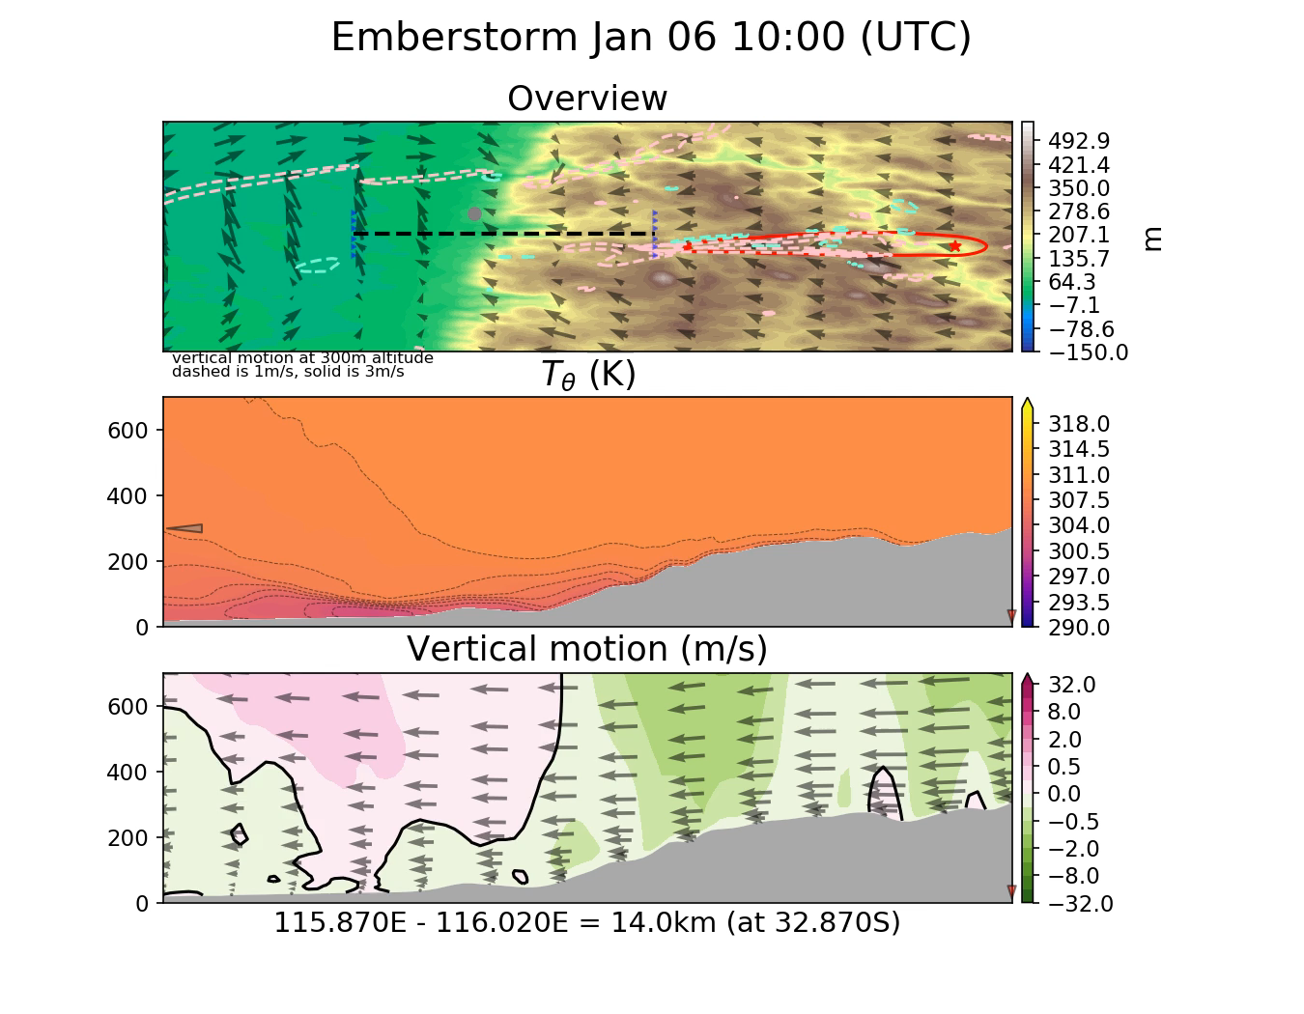
Notes:
13
13

Slide 14
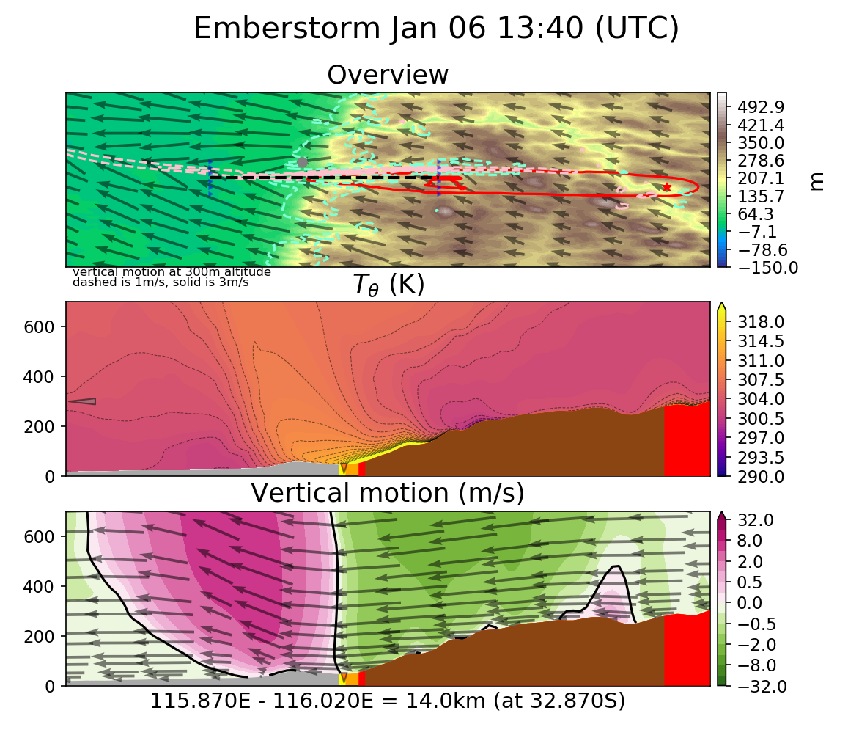
Clear Jump
Notes:
14
14

Slide 15
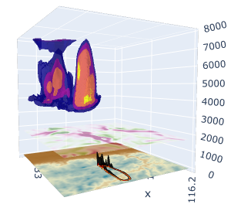
Cool
Notes:
15
15

Slide 16
Other opportunities
Talk: RFS client meeting
Poster: ACCOMC CGASM
Attendance:
BOM R&D conference
ACAWSI summer institute
AFAC fire conference
Seminars and webinars:
ACCESS
NWP validation
NCI data product access
…
Knowledge leeching:
NCI productivity experts are everywhere
Fire/Met/Modelling experts too
Notes:
16
16

Slide 17
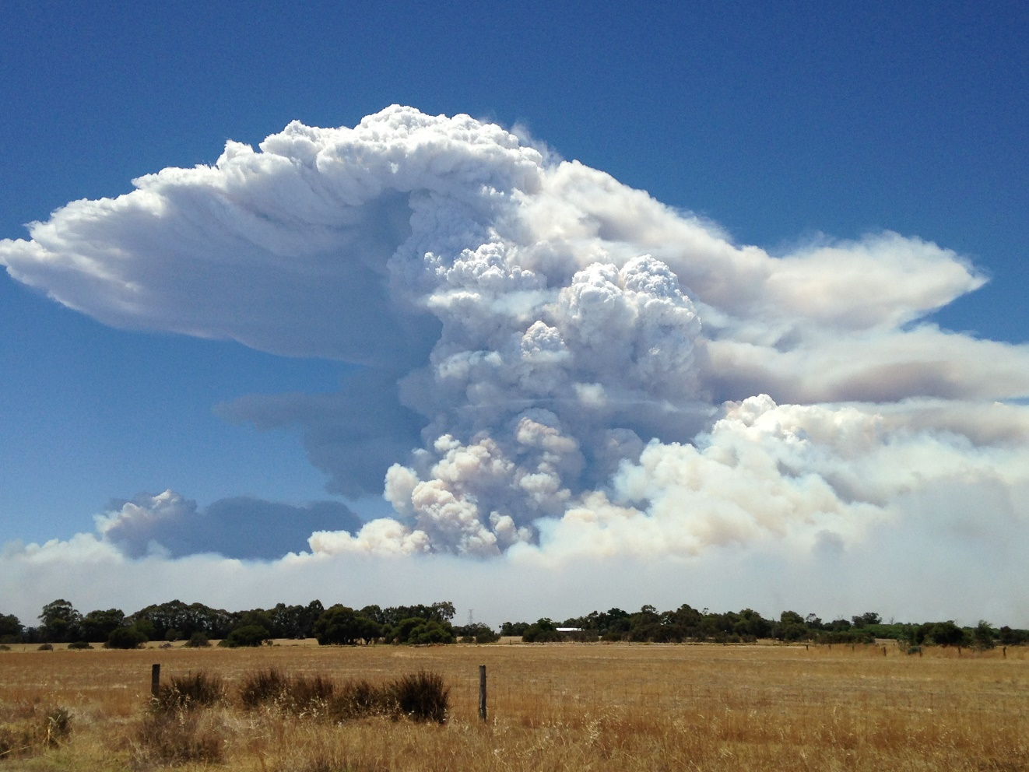
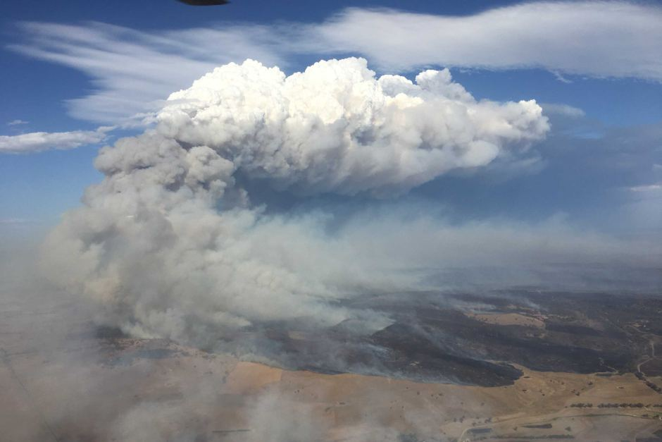
Thanks
Mika Peace,
Jeff Kepert,
Harvey Ye,
Jenny Fisher,
Kevin Tory
Notes:
17
17

Slide 18
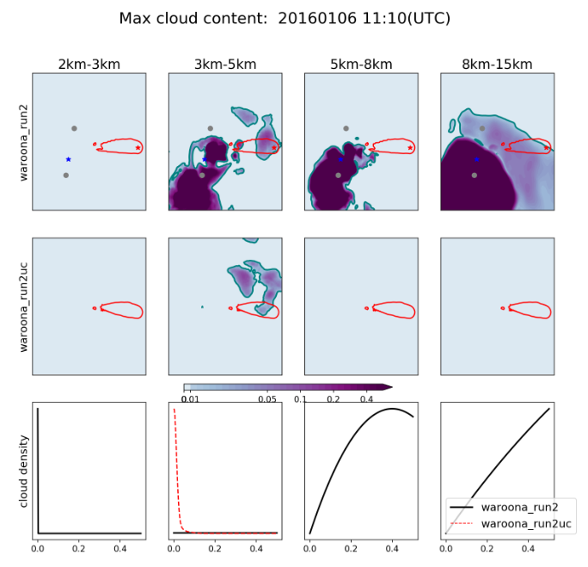
Uncoupled run
Notes:
18
18

